Slide 1



SC1015 Introduction to Data Science and AI Mini Project
Credit Card Fraud
Adrian Ang, Agnes Tan, Jabez Ng
Notes:
Hi everyone, we are Team 2 from Tutorial group SC10. Our group consists of Adrian, Jabez, and myself, Agnes. We hope that you enjoy our presentation in the next few minutes. ​

Slide 2
Problem
Most Common Identity Fraud
Motivation and Formulation
Losses $28.65 billion worldwide in 2019
Covid-19 is playing a major role
Increase 44.6% to 393,207 in 2020
Leverage machine learning
Notes:
In this project, we will be looking into the topic of Credit Card Fraud. Credit card fraud is one of the most common types of identity theft in today’s digital age and the monetary costs incurred are very large. This form of theft has increased due to Covid-19 and this upward trend continues to be seen.
This then leads us to the aim of our project which is to leverage on machine learning algorithms to identify a way to accurately detect fraudulent credit card transactions.​
The motivation for this project is to be able to greatly minimize the potential loss of large amounts of funds for both businesses and individuals if we can achieve a near 100% accuracy rate in detection. ​
​

Slide 3
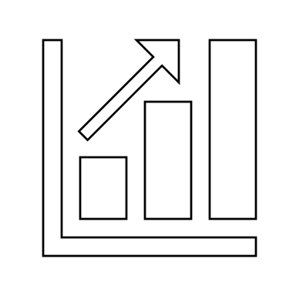





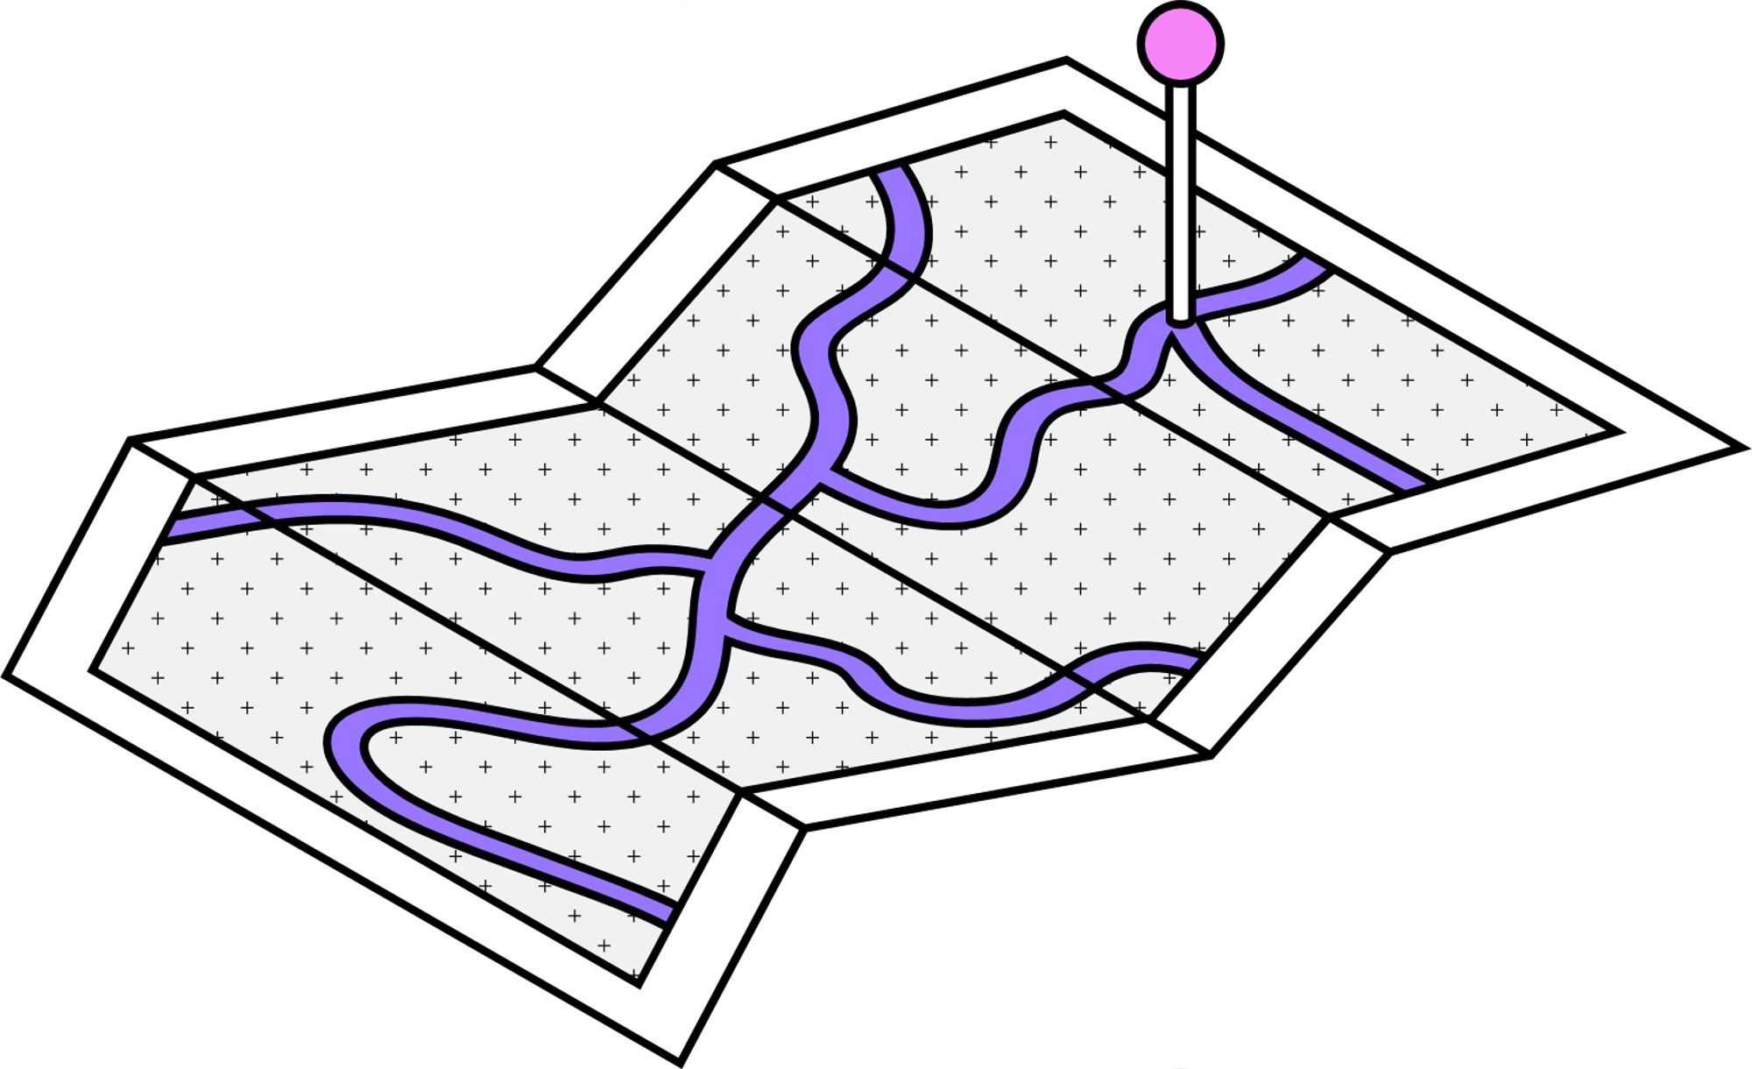
DATASET
FEATURE ENGINEERING
MODEL
PROBLEM
STATEMENT
EDA
BALANCING
Notes:
This will be the overview of our presentation.

Slide 4

Problem Statement
Notes:
First, we will talk about our problem statement. ​

Slide 5
Problem Statement
With the growing frequency of fraudulent credit card transactions, we need to be able to detect fraudulent transactions with great accuracy by modeling past credit card transactions with the knowledge of the ones that turned out to be fraudulent.
Notes:
<read slide>​

Slide 6
Dataset
Notes:
Introducing our dataset,

Slide 7



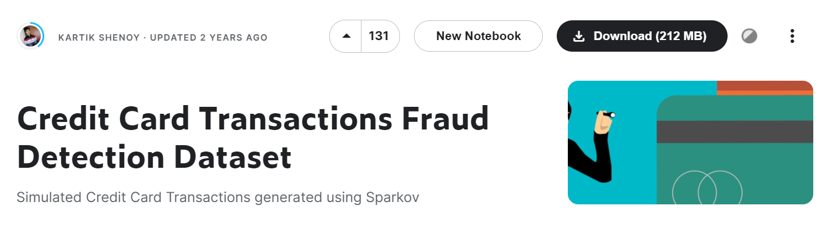
Dataset
555,710 entries is a significant amount of data, so we decided to take just 1% of the entries. Thus, we reduced our dataset size to 5557 entries.
Notes:
It is sourced from Kaggle, uploaded by KARTIK SHENOY. ​
More specifically, it is a simulated credit card transaction dataset containing legitimate and fraudulent transactions over 2 years in 2019 and 2020. It covers credit cards of 1000 customers doing transactions with a pool of 800 merchants.

Slide 8
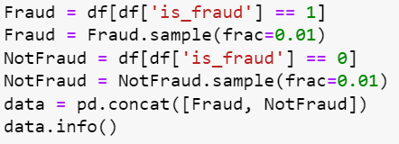
Dataset
This piece of code here randomly picks 1% of data that is in the is_fraud = 0 category and 1% of data that is in the is_fraud = 1 category.
Notes:
The original dataset had over 5 hundred thousand entries which were too large for our computers to process. Hence, we reduced our dataset to just 1% of it, which makes up 5557 entries. We made sure to take 1% of fraud and non-fraud entries each, to ensure that their ratio remains unchanged.

Slide 9

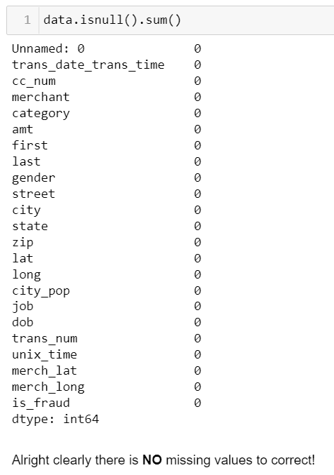
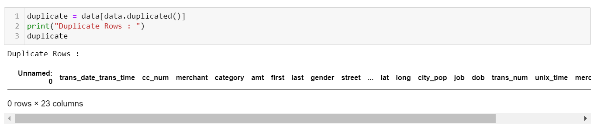
Dataset
Notes:
We also observed that there were no NULL values or duplicate data in our dataset. As such, we do not need to worry about missing information for certain entries or any obscurities. ​

Slide 10
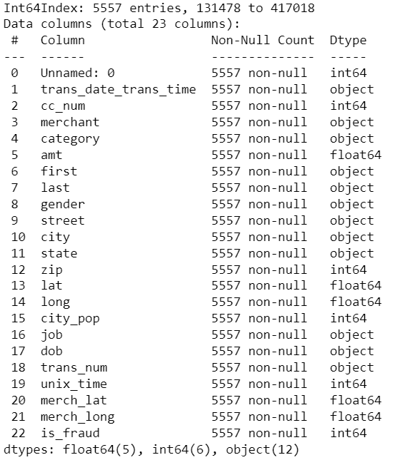

Variables
Numerical
Categorical
Time Series
Notes:
Overall, our dataset consists of 23 different variables which are numerical, categorical and time-series data types.

Slide 11

Correlation
Notes:
We then did some exploring on our dataset.

Slide 12


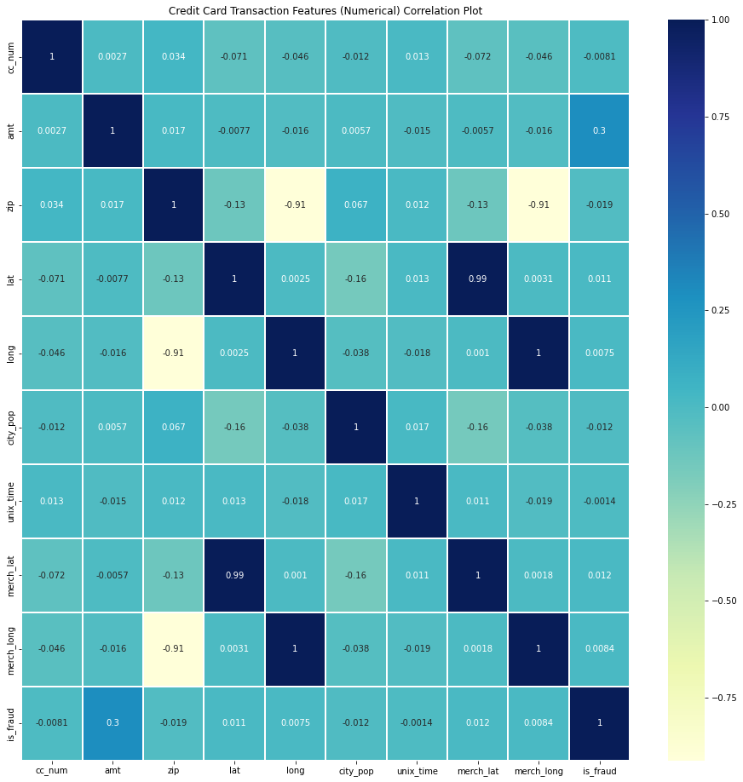
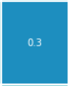
Correlation
‘amt' is the most closely related to 'is_fraud’.
The overall correlations with ‘is_fraud’ are relatively weak, thus we will need to perform feature engineering on our raw data which will be covered later.
Notes:
we first utilized a heatmap to better observe the correlations between variables. We can see that (click) ‘amount’ is the most closely related to ‘is_fraud’, with a correlation value of 0.3. ​
(click) However, the rest of the variables have a relatively weak correlation with ‘is_fraud’. As such, we will have to perform feature engineering on our raw data to produce new features with better correlations which can improve our model performance. ​

Slide 13

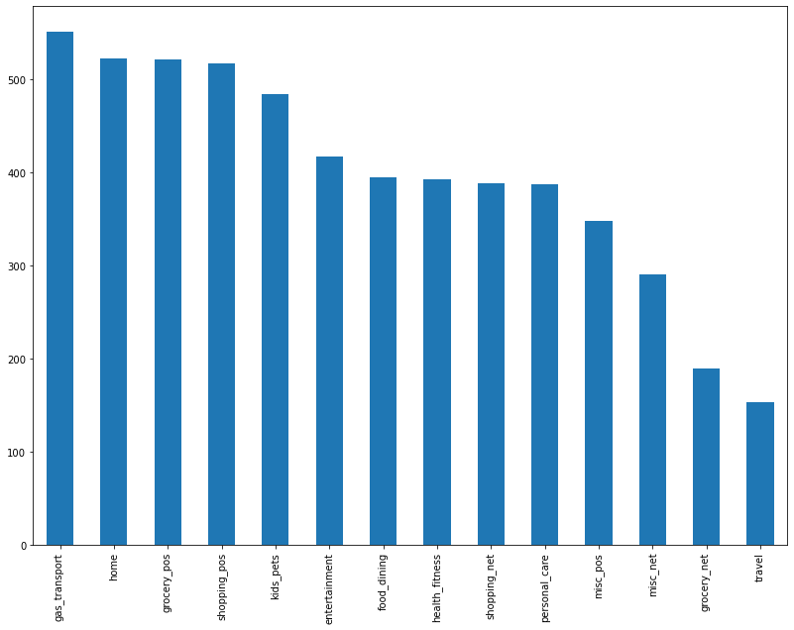
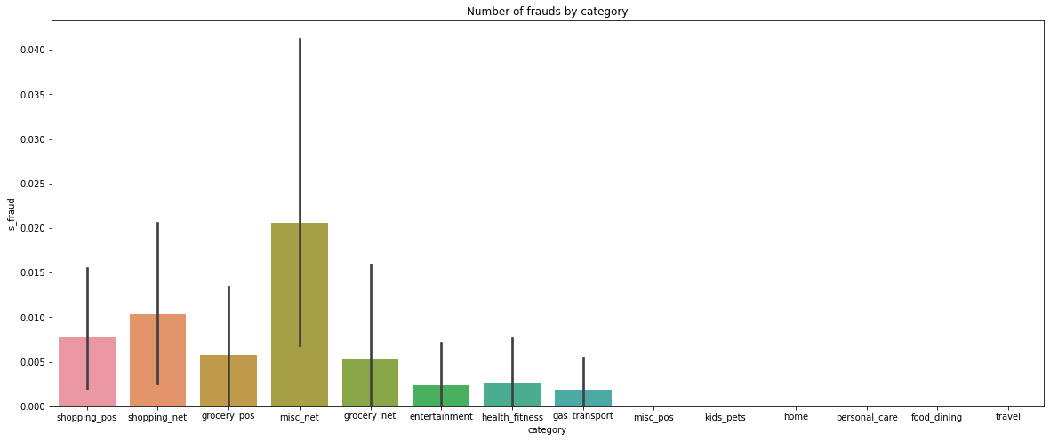
Category
Notes:
We also dived into (click) categorical variables and derived that the most common purpose among the transactions was (click) for transport gas payment.
(click) Furthermore, the category with the MOST number of fraudulent transactions (click) is misc_net. ​

Slide 14
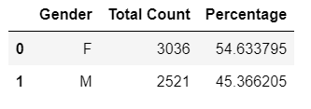
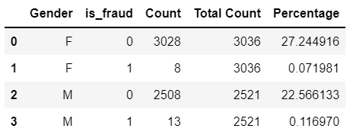
Gender
A greater proportion of females carry out transactions which may signify more females are victims to fraudulent transactions
However, males take up a higher proportion of individuals with fraudulent transactions.
Notes:
(click) For the variable ‘gender’, we observed that a greater proportion of females carry out credit card transactions which could result in more females falling prey to transaction fraud.
(click) However, males make up a higher proportion of individuals with fraudulent transactions. ​

Slide 15


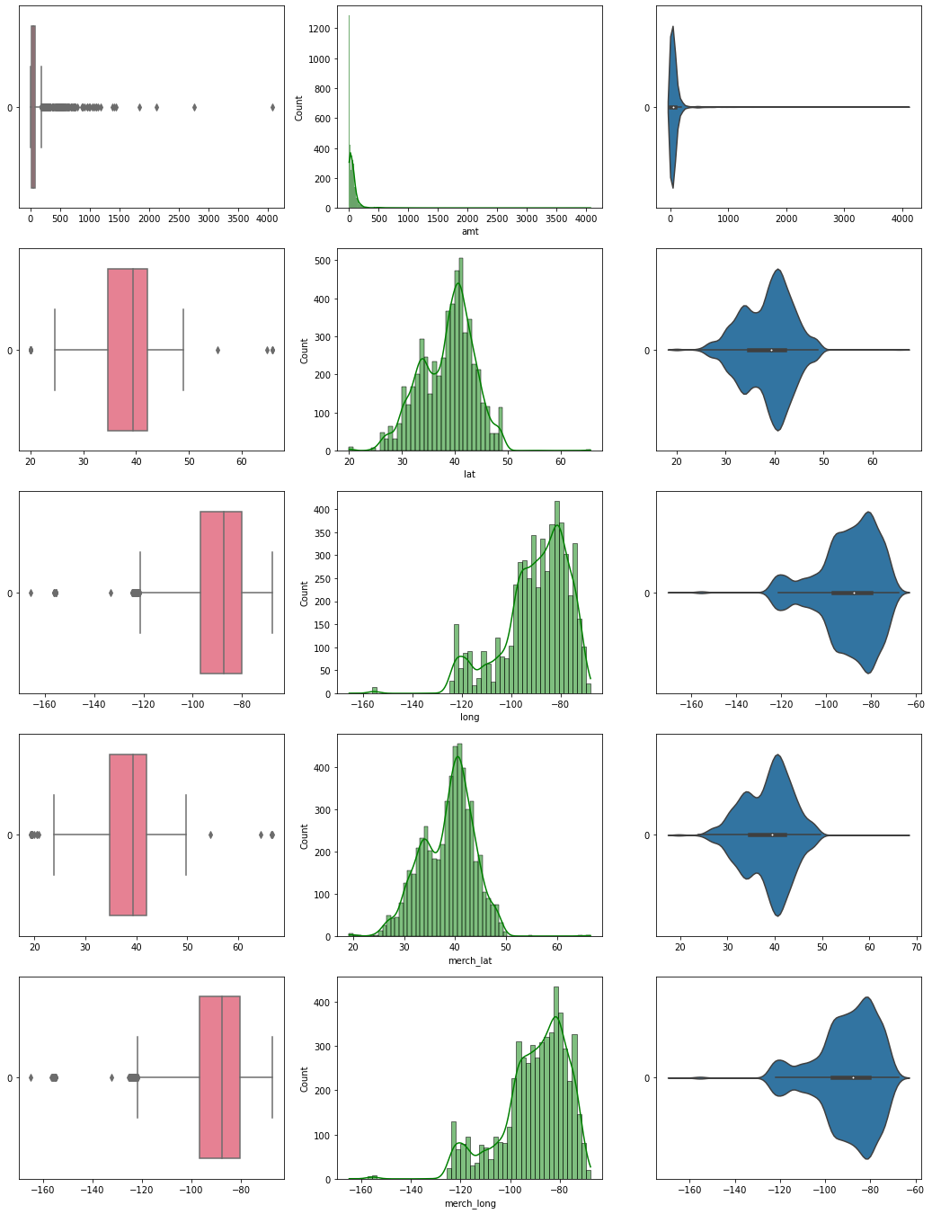
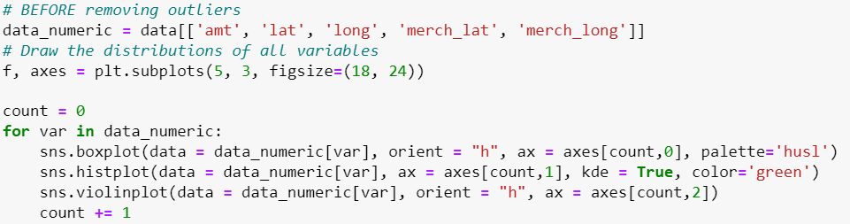
Outliers
Outliers are present. However, these outliers arise NOT because of measurement error but because they are NATURAL OUTLIERS due to the nature of our dataset.
Thus, we do not remove these outliers as we have realized that these outliers are in fact fraudulent transactions.
Notes:
When performing multi-variate analysis on the numerical variables, we noticed the presence of outliers due to flushing observed on the various plots used to visualize the data. ​
Nonetheless, we will NOT remove these outliers as in the case of fraudulent transactions, these outliers do not arise due to measurement errors but because they are natural outliers that could be crucial in detection. ​

Slide 16
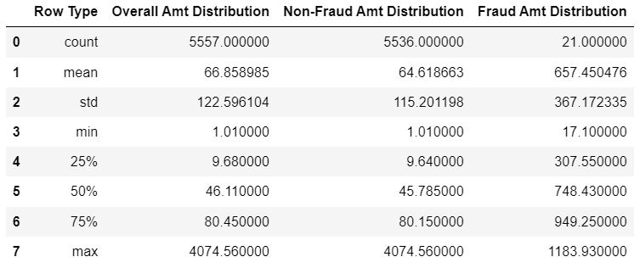


!Fraud vs Fraud
Amount spent in fraudulent transactions is generally higher, ranging from $17.10 to $1183.93.
The mean amount for fraudulent is also significantly higher.
Notes:
We also did a uni-variate analysis between the highest correlation variable, ‘amount’ and ‘is_fraud’.
The statistical summary of the analysis shows that there the central tendency of the transaction amount that is fraudulent, comparing to that of NOT fraudulent, fraudulent amounts are generally higher and more dispersed from the average.

Slide 17

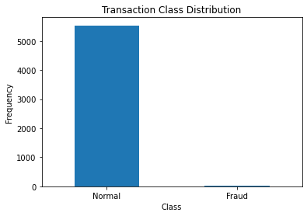
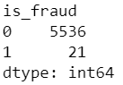
Balance
Notes:
Finally, we noticed a huge imbalance in data for the variable 'is_fraud'. The majority of the entries belonged to the 'not fraud' category while only 21 belong to the 'is fraud' category.
We will tap on different techniques to resolve the data imbalance issue later.

Slide 18

Feature Engineering
Notes:
After our exploratory data analysis,​ our group performed feature engineering on our dataset in light of the poorly correlated features.​
Considering the rather poor correlation values observed during EDA, we plan to generate NEW features to aid in obtaining a better machine learning model

Slide 19


Feature Engineering
Poor correlation values
NEW features with better correlation values !

Slide 20


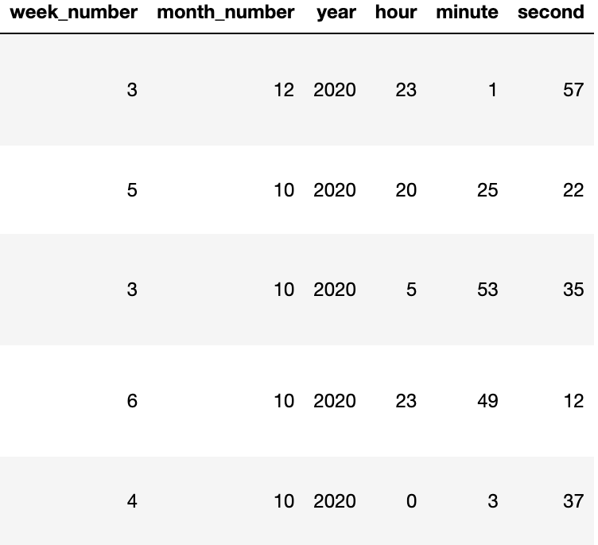
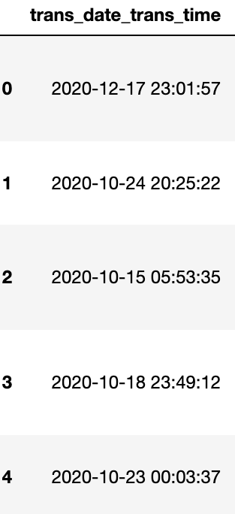
Time
week_number here refers to the day of the week with 0 (Monday) and 6 (Sunday)
Notes:
For the variable, ‘transaction date time’, we managed to extract and separate the values that correspond to the day of the week, the month number, year, hour, minute, and seconds.

Slide 21
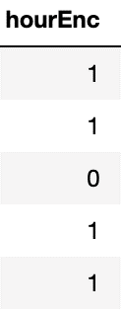
Hour Encoding
’1’
If transaction time is later than 2100H and earlier than 0500H it is encoded as ‘1’
‘0’
Else it is encoded as ‘0’
Notes:
Our group hypothesized that there is a higher possibility that fraudulent transactions take place during certain time periods. As such, we devised a new feature called ‘hour encoding’. Transactions that took place later than 9 pm and earlier than 5 am would take on the value of 1. Else it will be encoded as 0.

Slide 22
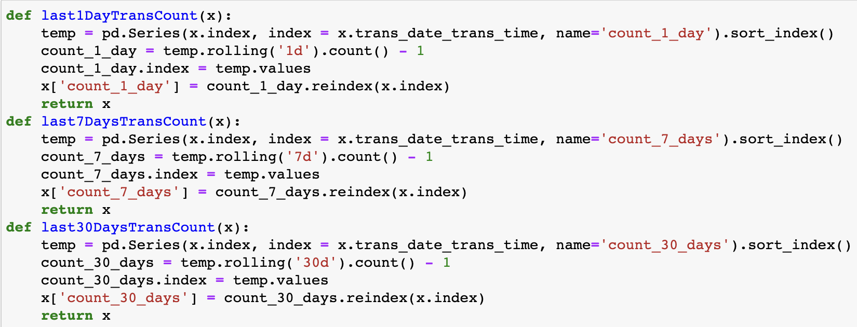
Frequency of Transactions
We can generate the frequencies of transactions performed in the last day, week and month. We utilized Python Pandas rolling window calculation function.
1 Day
7 Days
30 Days
Notes:
Additionally, we managed to utilize the python pandas rolling window calculation function to enumerate the frequencies of transactions performed in the last day, week, and month.

Slide 23
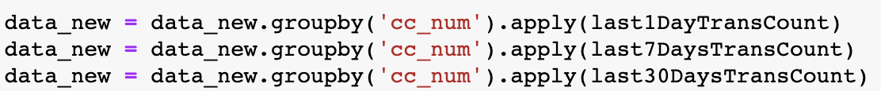
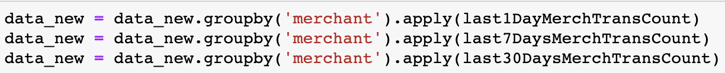
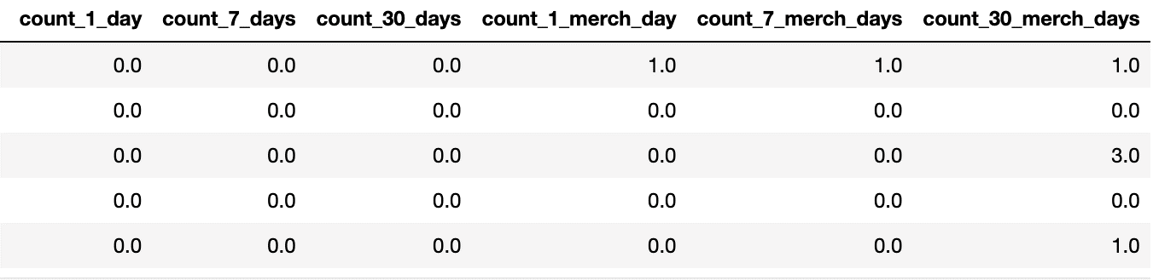
Frequency of Transactions
We will then perform aggregation of the values obtained in relation to the features ‘cc_num’ and ‘merchant’ respectively using the Python Pandas groupby function.
Notes:
Following this, we performed feature aggregation of the values with the variables ‘cc_num’ and ‘merchant’ respectively. ‘cc_num’ here corresponds to the individual that carried out the transaction

Slide 24
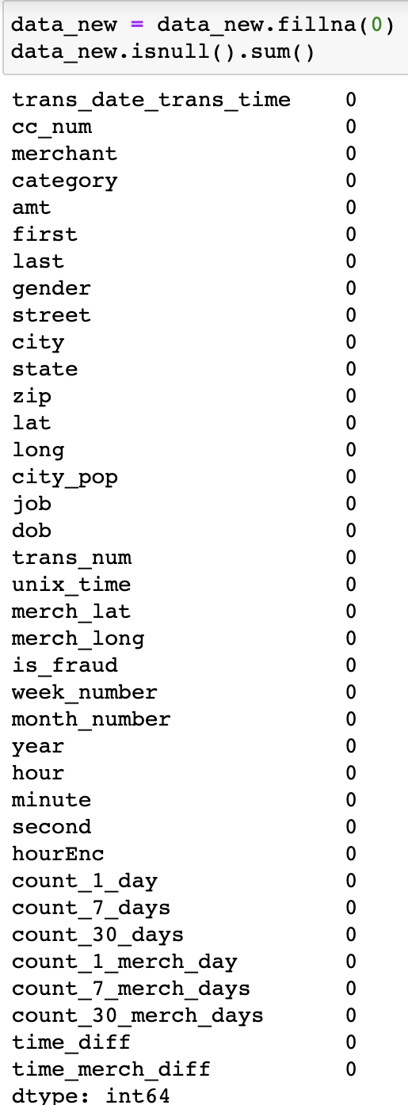
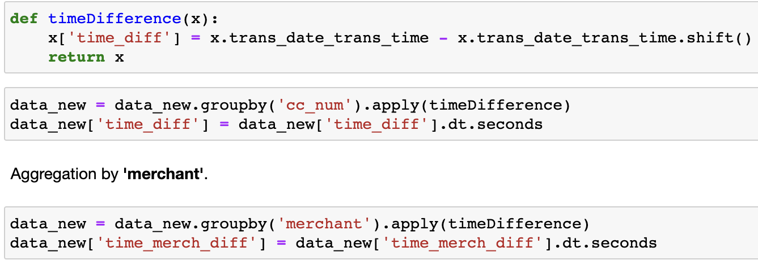
Time Since Last Transaction
We can also create a feature that takes on the RECENCY of the transaction.
Calculate this by finding the difference between the datetime feature and the index shifted datetime feature.
We will use Pythons shift() function for time series data to carry this out. NULL values observed will be filled with 0.
Notes:
We also believed that the recency of the transaction might be influential. If we observe a sudden increase in the number of transactions in the last day, for example, it might indicate the presence of fraudulent transactions.
To obtain the time since the last transaction, we use the python pandas shift function on the transaction date time before subtracting that shifted value from the original date-time value.
Because we will bound to have missing values when using the shift function, we filled those NULL values with 0. Similar to transaction frequency, we performed aggregation with respect to ‘cc_num’ and ‘merchant’.

Slide 25
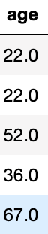
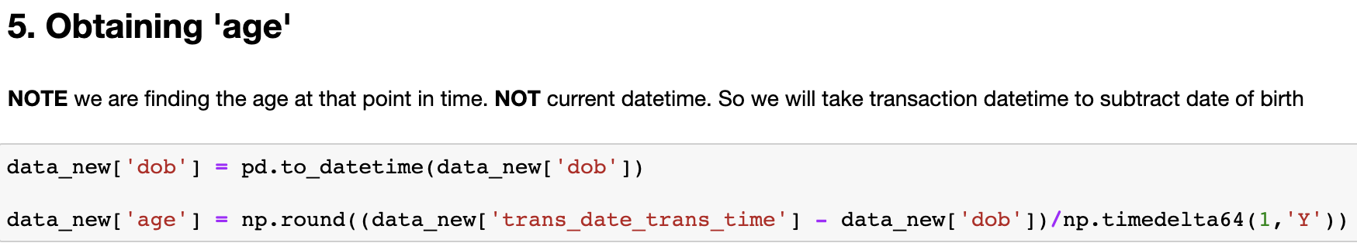
Age
Notes:
Our group also noticed that we could calculate the age of the individual making the transaction using the variable, ‘date of birth’. We first convert the date of birth value into a datetime format before subtracting it from the Date Time value of the transaction. This way we can find the age of the individual at the point when the transaction was made.

Slide 26
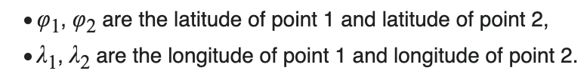
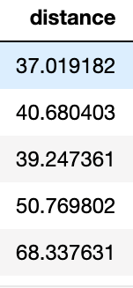
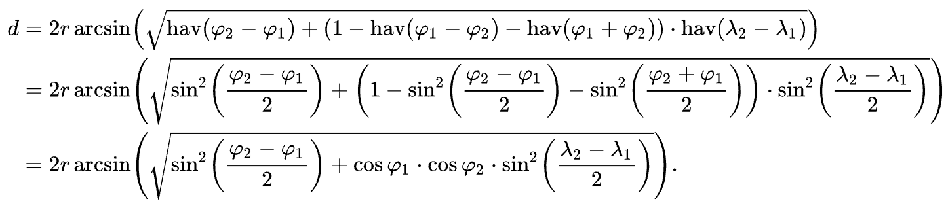
Distance
Because we have the features ‘lat’ (Latitude) and ‘long’ (Longitude) for BOTH the individual and the merchant, we can calculate the distance between the two parties. We will use the haversine function to calculate the distance.
Notes:
On top of this, we realized that we could also generate the distance between the individual and the merchant using the latitude and longitude values for both parties. To do this, we made use of the haversine function to accurately calculate the distance.

Slide 27
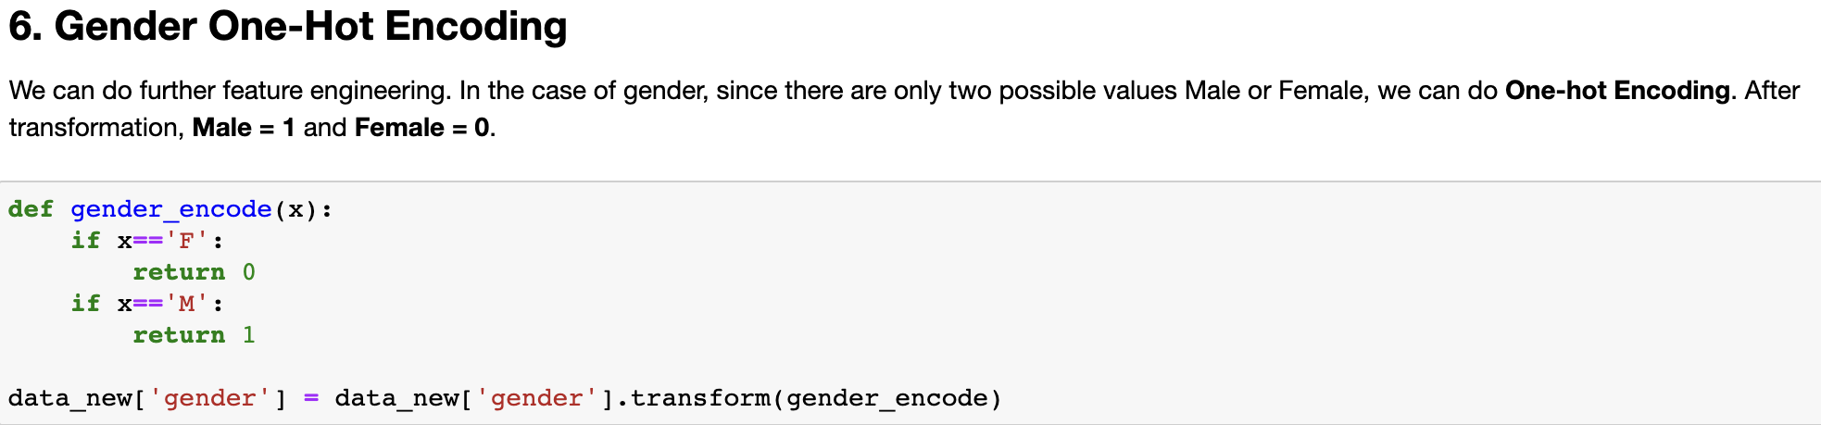
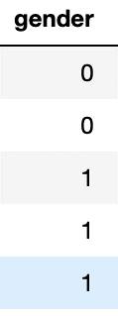
Gender
Notes:
Lastly, to deal with categorical variables like gender and category, we applied one-hot encoding on these variables due to the low number of unique values for each variable. For gender, there are only 2 unique values while 'category' has 14 unique values. Males will be encoded as 1 while females as 0.

Slide 28
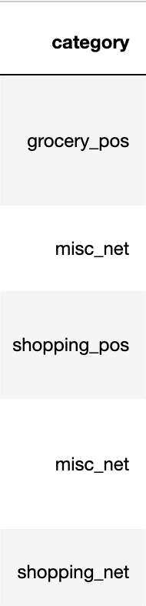
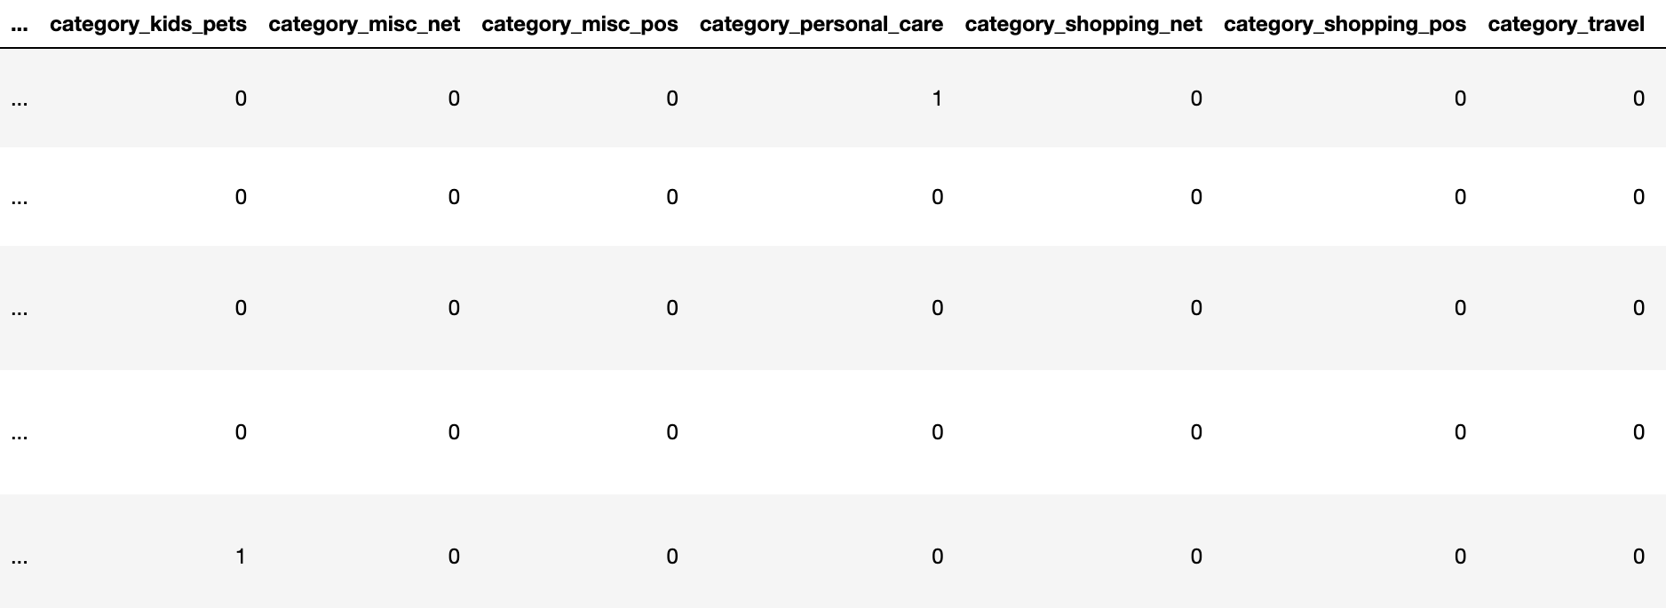
Category
Convert categorical values into numerical values. Because the feature ‘category’ has only 14 unique values, we can perform one-hot encoding due to the low number of unique values.

Slide 29
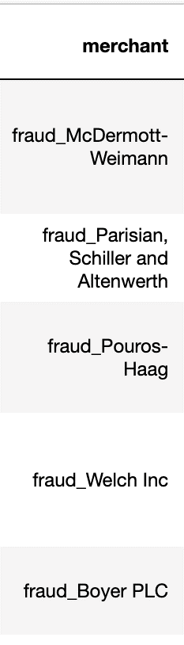
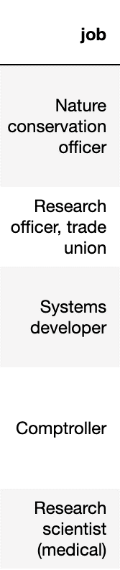
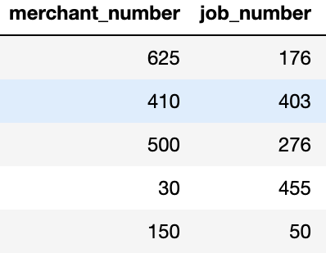
Merchant & Job
Unlike ‘category’ , ‘merchant’ has 690 unique variables while ‘job’ has 464 unique variables. As such, one-hot is not feasible. Instead, we will utilize label-encoding.
It is crucial to note that in order to prevent data leakage, label-encoding will be done AFTER the train-test split.
&
Notes:
For the categorical values like merchant and job, because the number of unique values is too large for one-hot encoding to be feasible, we decided to perform label encoding instead. Both variables have more than 450 unique values. It is crucial to note that we performed the label encoding AFTER our train-test split to mitigate against the problem of data leakage.

Slide 30
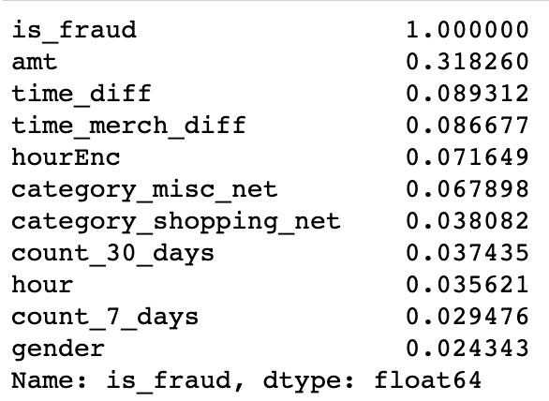
Feature Selection
ORIGINAL FEATURES |  | EXTRACTED FEATURES
cc_num merchant_number first last gender street city state zip city_pop job_number trans_num unix_time week_number month_number hour minute second hourEnc count_1_day count_7_days count_30_days count_1_merch_day count_7_merch_days count_30_merch_days | time_diff time_merch_diff age distance category_entertainment category_food_dining category_gas_transport category_grocery_net category_grocery_pos category_health_fitness category_home category_kids_pets category_misc_net category_misc_pos category_personal_care category_shopping_net category_shopping_pos category_travel merchant_number job_number amt | amt time_diff time_merch_diff hourEnc category_misc_net category_shopping_net count_30_days hour count_7_days gender
Notes:
After completing the feature engineering, we then found the correlation values again with the new features and selected the top 10 features that had the highest correlation value with the variable is_fraud.

Slide 31
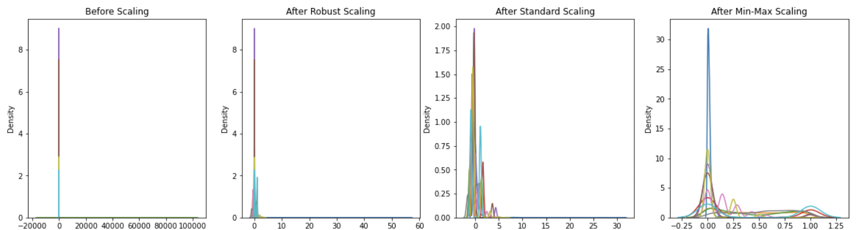
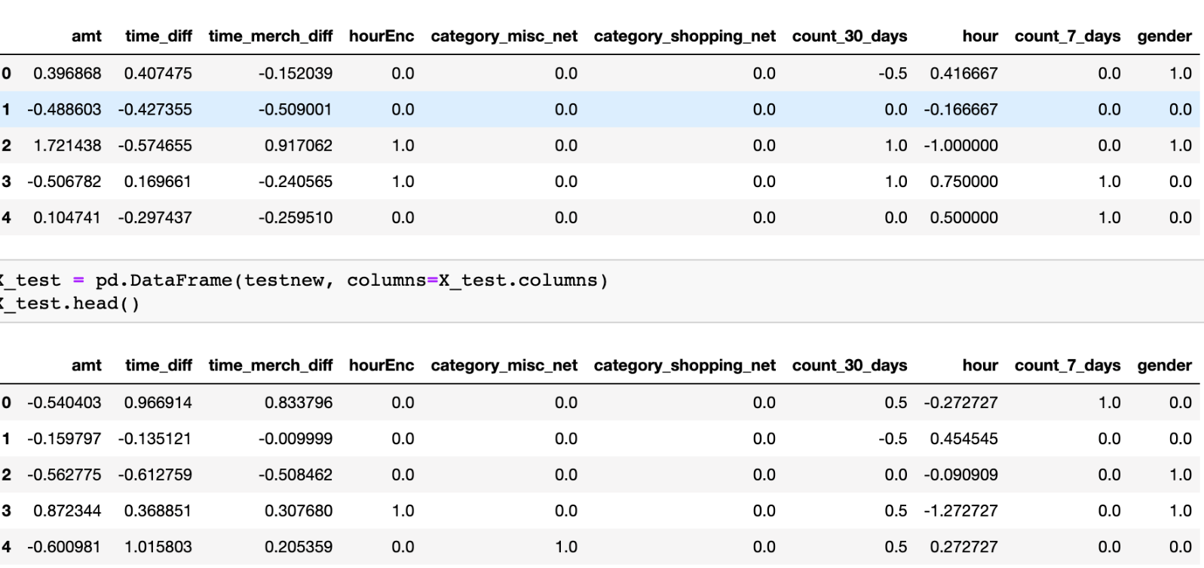
Feature Scaling
To prevent such large range variables from dominating the smaller ranger variables, we should do feature scaling.
ROBUST
STANDARD
MIN-MAX
As its name suggests it is ROBUST against outliers
Assumes a normal distribution in the data
Sensitive to outliers
Notes:
Machine learning algorithm just sees number — if there is a vast difference in the range say few ranging in thousands and few ranging in the tens, and it makes the underlying assumption that higher ranging numbers have superiority of some sort. So these more significant number starts playing a more decisive role while training the model. As we will be using algorithms like K-nearest neighbors that is sensitive to magnitudes, scaling is necessary.
Min-max is sensitive to outliers. In this case, we have natural outliers so it would not be ideal to use it.
Standard scaler assumes that our data is normally distributed. However, it isn’t the case for our dataset. As such it too isn’t ideal.
Due to our large data size, and the prescence of natural outliers, Robust scaler is the most ideal because, as its name suggests, it is robust to outliers.
SCRIPT:
Subsequently, we used feature scaling techniques to scale our extracted data. The reason for scaling is pivotal as variables such as ‘amount’ have a vast range in comparison to one-hot encoded data like the hour encoding. This large difference in the ranges may result in higher ranging values having some superiority or dominating the lower range values. Furthermore, as we will aim to test machine learning algorithms like K-nearest neighbors which are sensitive to magnitudes, scaling is necessary.
We tested 3 different scalers, namely min-max, standard, and robust scalers. We eventually decided to drop the standard scaler as our data is not normally distributed and this scaler assumes a normal distribution. Min-max is sensitive to outliers and considering the presence of natural outliers, it would not be feasible to go with this. On the other hand, the robust scaler is, as its name suggests, robust against outliers. Therefore, we went with the robust scaler.

Slide 32
Balancing
Notes:
As we recall, our dataset was severely imbalanced and highly skewed towards non fraudulent transactions.​ Hence, we need to balance our dataset such that the magnitude of each class is comparable​

Slide 33


Balancing
3 Methods
Under Sampling
Oversampling
SMOTE
Notes:
Imbalanced data can negatively affect model performance and precision especially since we are using a binary classifier (namely, Fraud vs no fraud). ​
(click) We will be testing out these 3 techniques to aid in balancing our dataset.​

Slide 34


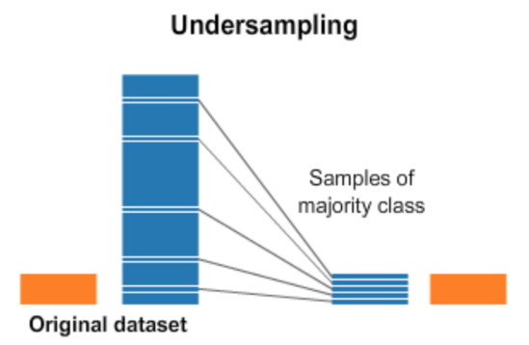
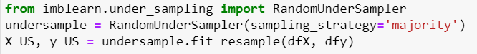
Under Sampling
Under Sampling is a technique to balance uneven datasets by keeping all the data in the minority class and decreasing the size of the majority class.
Notes:
The first technique would be under-sampling. For this, we randomly choose is_fraud entries to delete until the frequencies are the same
However, The heavy deletion of observations in this random manner may lead to the deletion of some useful information from the dataset. As such, this is NOT the best technique.

Slide 35

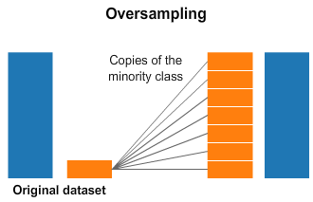
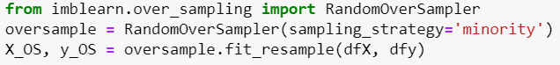
Over Sampling
Over Sampling is a technique to balance uneven datasets by randomly duplicating examples from the minority class and adding them to the dataset.
Notes:
The second technique is oversampling where we randomly choose is_fraud = 0 entries to duplicate until frequencies are the same and the data set is balanced.
However, by making exact copies of existing examples, we increase the chances of model overfitting, and it is also NOT the best technique as such.

Slide 36
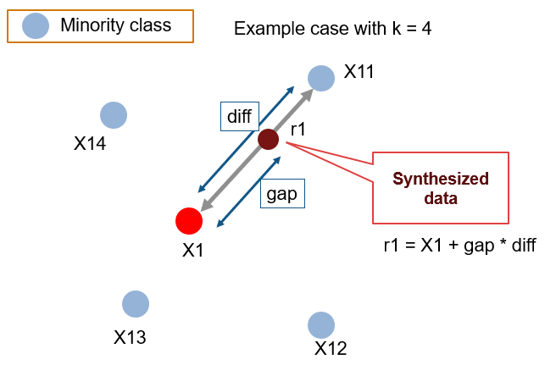
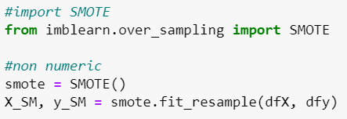
SMOTE
Instead of duplicating data, Synthetic Minority Oversampling Technique (SMOTE) oversamples data in the minority class by synthesizing new data from existing ones
Notes:
The final technique would be SMOTE. SMOTE works by selecting examples that are close in the feature space, drawing a line between the examples in the feature space, and drawing a new sample at a point along that line.
A random example from the minority class is first chosen. Then a constant value k of the nearest neighbors for that example is identified (typically k=5). A randomly selected neighbor is then chosen, and a synthetic example is created at a random point between the two examples.

Slide 37
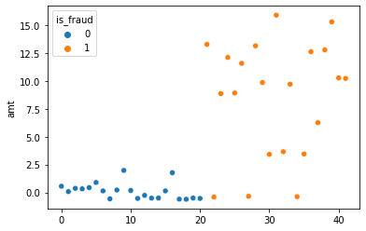
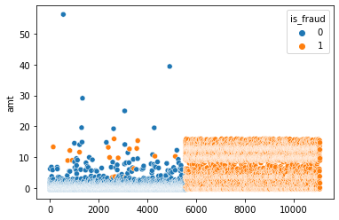
SMOTE
Under Sampling
Correlation between amt and is_fraud is 0.762971
SMOTE
Correlation between amt and is_fraud is 0.741037
Notes:
Although the correlation between ‘amount’ and is_fraud is higher for Under Sampling, the massive deletion of data is risky.
Therefore, SMOTE will be the most suitable technique out of the 3 to balance our dataset.

Slide 38

Classification Models
Notes:
Finally, our Classification Model.

Slide 39


Classification Models
4 Models
Gaussian Naïve Bayes
Random Forest Classifier
K-Nearest Neighbors
XGBoost
Notes:
Instead of using the normal way of regression and classification method, we decided to look into 4 different types of Classification models namely the Gaussian Naïve Bayes, Random Forest Classifier, K-Nearest Neighbors, and lastly XGBoost.

Slide 40




Gaussian Naïve Bayes
Notes:
Firstly, the Gaussian Naïve Bayes which is a variant of the Naive Bayes with the addition of Gaussian Normal distribution and support of continuous data.
The train’s Classification accuracy is 0.97 with a True Positive Rate of 1.0 and a False Positive Rate of 0.05. The test’s Classification accuracy is 0.97 as well with a true positive rate of 1.0 and a false positive rate of 0.04. The F1-Score for the train is 0.973 and the test is 0.976.

Slide 41


Random Forest Classifier
Notes:
Secondly, the Random Forest Classifier.
The train’s Classification accuracy is 0.99 with a true positive rate of 1.0 and a false positive rate of 0.01. The test’s classification accuracy is 0.99 with a true positive rate of 0.99 and a false positive rate of 0.01. The F1-score for both the train and test is 0.994.

Slide 42


K-Nearest Neighbors
Notes:
Thirdly, the K-Nearest Neighbors. The train’s Classification accuracy is 0.999 with a true positive rate of 0.999 and a false positive rate of zero. The test’s classification accuracy is 0.998 with a true positive rate of 1 and a false positive rate very close to zero. The F1-score for the train is 0.999 and the test is 0.998.

Slide 43



XGBoost
Notes:
Lastly, XGBoost.
XGBoost is an implementation of the gradient boosted trees algorithm. Gradient boosting is a supervised learning algorithm, which attempts to accurately predict a target variable by combining the estimates of a set of simpler, weaker models.
The train’s Classification accuracy is 1.0 with a true positive rate of 1.0 and a false positive rate of zero. The test’s classification accuracy is 0.999 with a true positive rate of 1 and a false positive rate very close to zero. The F1 score for the train is 1.0 and the test is 0.999.

Slide 44

ROC & AUC
Notes:
Finally, we did AUROC Evaluation which actually allow us to determine the best and most suitable model for credit card fraud detection.
Comparing all the four different Classification models for machine learning, we can see that XGBoost not only has the best classification accuracy, it also has the highest True Positive Rate, Lowest False Positive Rate, and with the confirmation of the AUROC Evaluation, we were confident that the best possible machine learning for us to implement would be XGBoost.

Slide 45


Implementation of Machine Learning
Reduce Fraudulent Payment
Improve Retailer Confidence
Notes:
With this implementation, we will be able to determine which credit card transaction is fraudulent and with that completes our aim for this project where we are able to achieve close to 100% accuracy in the detection of any fraudulent transaction.

Slide 46
Something New ☺
Poor correlation → Feature Engineering
Vast magnitude difference for variables → Feature Scaling
Unbalanced Data → SMOTE (under and oversampling)
Different Machine Learning techniques (XGBoost)
Notes:
There are several new areas of data science we touched on throughout this project.
Firstly, when we realized that our variables had a weak correlation with each other, we did feature engineering to improve the variables such that they will be a better match.
Second, with the variables of different magnitudes, it was hard to compare them as one can easily overwhelm the other. Thus, feature scaling could help mitigate this issue.
Third, to make the is_fraud category comparable, we had to balance the dataset. We tried 3 different ways and found that SMOTE was the best.
Last but not least, for our machine learning, we decided to adopt XGBoost among the many we’ve tried because it manages to reap the best results.

Slide 47
Data-Driven Insights
Likely to be Fraudulent:
Abnormally high amounts of $$
Transactions done before 5 am or after 9 pm
Category of transaction is not specific
The recency of the transaction
Notes:
Based on our EDA, we have concluded that transactions with a higher amount of money involved, done in the late night or wee hours of the day are more likely to be fraudulent.
This makes sense because thieves will take full advantage of the money that is not theirs and would usually do transactions in parts of the day where there are less likely to be witnesses. Fraudulent transactions also do not belong to a certain category because the things the money is spent on are varied. For example, the money can be used to spend on illegal items or … basically anything.

Slide 48
Outcome
Machine Learning
Transaction Fraudulent?
Mitigate Fraud Usage
Observe trend
With the success of the credit card fraud detector, we would be able to greatly minimize the potential loss of large amounts of funds, saving consumers and businesses the time and resources needed to resolve the fraud transaction.
Notes:
Using our ML, authorities or credit card holders can:
Determine if a transaction is fraudulent or not and hereby mitigate against the costs that consumers may incur for items that they did not purchase
Observe the trend behind fraudulent transactions which can help retailers be more vigilant.
With the success of the credit card fraud detector, we would be able to greatly minimize the potential loss of large amounts of funds, saving consumers and businesses the time and resources needed to resolve the fraud transaction.

